Slide 1




Enrollment Overview Congressional Hearing 11.6.15
Our Current Position of Strength
(it is okay to feel good about this)
Our Students
Our Demographic Reality
Through 2028
Our Competitors
Our Price and Value
Our Plan(s)

Slide 2

Illinois 4 Year Public Enrollment
Spring 2013 Compared to Spring 2015
Strength

Slide 3
Notes:
You probably only need one of these. Either the number change or the percent change. They are representing the same thing, graphically

Slide 4
7 Year Change New Student Enrollment – Fall Semester
Strength

Slide 5
8 Year History Ethnicity – Fall Term
Change
Strength
* Change in Federal Ethnicity Reporting Guidelines

Slide 6
8 Year History SIUE Mean ACT
Strength

Slide 7

“…past performance does not necessarily predict future results.“
-Abraham Lincoln

Slide 8


Slide 9
Reality
chronicle.com/article/Who-Will-Reach-College-Age-in/144061#00/0-1

Slide 10
Regional States Pop. Reaching College Age 2014-2028
Reality

Slide 11
Ethnicity (IL) Population Reaching College Age 2014-2028
Ethnicity | % Change | # Diff
White | -17.40% | -17,208
Hispanic | 9.70% | 3,678
Black | -19.80% | -6,180
Asian | 10.20% | 691
Strength

Slide 12
Ethnicity: STL Population Reaching College Age 2014-2028
Reality
Data includes St. Louis City and St. Louis County

Slide 13




Top 5: National Student Clearinghouse
SIUE Admitted Freshmen Enrolling Elsewhere

Slide 14
National Student Clearinghouse
SIUE Admitted Freshmen Enrolling Elsewhere
2012 2,089 students 333 institutions |  |  |  |  | 2013 3,847 students 401 institutions
1 | ISU | 5.94% | 164 |  | 1 | SIUC | 5.82% | 224
2 | Mizzou | 4.92% | 147 |  | 2 | ISU | 4.91% | 189
3 | SIUC | 4.65% | 139 |  | 3 | UIUC | 3.72% | 143
4 | UIUC | 4.38% | 131 |  | 4 | Mizzou | 3.56% | 137
5 | WIU | 3.85% | 115 |  | 5 | NIU | 3.38% | 130

Slide 15
National Student Clearinghouse
SIUE Admitted Freshmen Enrolling Elsewhere
2014 3,982 students 403 institutions |  |  |  |  | 2015 3,854 students 333 institutions
1 | SWIC | 6% | 229 |  | 1 | SWIC | 6% | 239
2 | SIUC | 5% | 191 |  | 2 | LCCC | 6% | 227
3 | ISU | 5% | 181 |  | 3 | ISU | 5% | 174
4 | LCCC | 4% | 158 |  | 4 | SIUC | 4% | 148
5 | WIU | 3% | 132 |  | 5 | LLCC | 3% | 129

Slide 16

Lowest Illinois 4-Year Tuition and Mandatory Fees
 | FY 2016
SIUE | 10247 | -
SIUC | 13137 | 2890
ISU | 13666 | 3419
WIU | 12889 | 2642
UIUC | 15626 | 5379
NIU | 14318 | 4071
UIS | 12411 | 2164
Notes:
Maybe add some of your famous circles or color a line, to draw their attention to your point.

Slide 17
FY 2013 Institutional Aid / IPEDs Discount Rate
How scholarship dollars keep us competitive
 | T&F | Ave. Inst. Aid | Disc. | Actual T&F
SIUE | 9251 | 901 | 10% | 8349
SIUC | 11528 | 1964 | 17% | 9564
ISU | 13080 | 1546 | 12% | 11534
WIU | 9980 | 1327 | 13% | 8653
UIUC | 17081 | 3304 | 19% | 13777
NIU | 12472 | 4249 | 34% | 8223
UIS | 10488 | 5164 | 49% | 5324

Slide 18
Annual Income by Race/Ethnicity
WICHE 2013 –working age population
The Illinois statewide median income was $37,126, compared with $35,147 for the nation.
At $43,687, Asians/Pacific Islanders had the highest median income,
followed by White non-Hispanics at $41,251.
At the low end of the income spectrum, Hispanics’ median income was $25,782, a quarter earning $15,377 or less. ( SIUE AGI $58,352)
One quarter of Black non-Hispanics earned less than $12,741, and their median income was estimated at $29,463.

Slide 19


Ability and Willingness to Pay
Fall 2014 Freshman Cohort
Academic Quality | EFC 000 | EFC 001-5000 | EFC 5001-8000 | EFC 8001-14000 | EFC GT 14000 | NO FAFSA | Grand Total
Total Enrollees | 398 | 355 | 147 | 277 | 784 | 102 | 2,063
Total Enrollment Yld | 32% | 36% | 39% | 49% | 48% | 6% | 31%
Total Avg Income Level | $19,093 | $46,116 | $73,394 | $93,576 | $166,220 | --- | $90,527
Total Retention Yld | 64% | 68% | 82% | 78% | 82% | 75% | 75%
Notes:
Add circles!

Slide 20
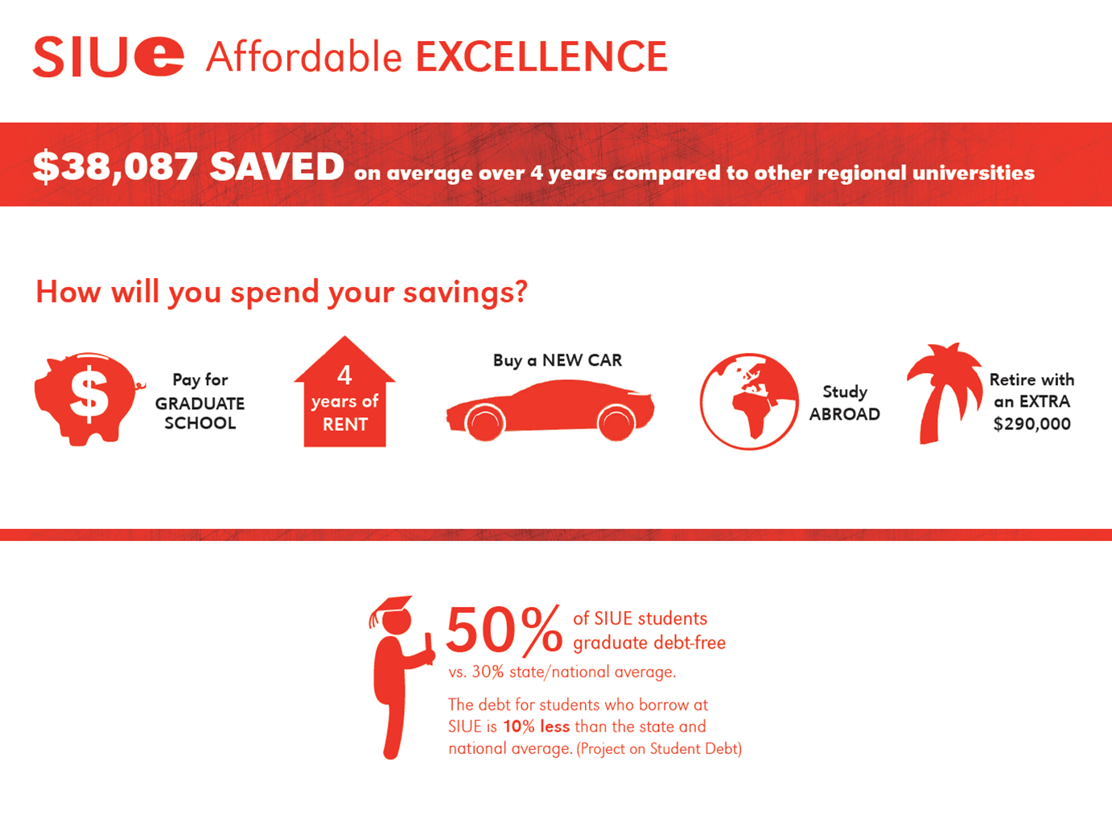

Slide 21

$46,800
average starting salary
for SIUE graduates.
That is more than
Illinois State University,
Saint Louis University,
Mizzou,
Indiana State,
University of Missouri St. Louis,
Loyola Chicago,
SIU Carbondale… the list goes on (payscale.com).
Notes:
I just re-formatted a little

Slide 22
The Enrollment Plan
Chancellor VV
  One more student than last year
  Emphasis on freshman class and filling the residence halls
  Growth in the Chicago market
  Maintain graduate enrollment
  Create dual admission programs with community colleges
  Modest discounting plan introduced
  Increased investment in marketing and branding
  Increased investment in professional academic advising

Slide 23
The Enrollment Plan
Chancellor JFB
  Strategic plan with specific KPI’s
    Grow freshmen, transfer, graduate, international, and online enrollment and enrollment through corporate partnerships.
    Grow retention w/emphasis on underrepresented students.
    Grow tuition revenue
  Specific Activities
    2+2’s with community colleges, international travel and formal MOU’s, ESLI, competitive discounting plan, regional states pricing, winter session

Slide 24
The Enrollment Plan
Increase awareness of SIUE.
Always grow the prospect pools, web traffic, campus visitors and applications.
Out work, out think, out perform the competition.
Exceed student’s expectations.
Keep up with the Deans and work with them to identify needs in the marketplace.
Make very good use of the breadth of our academic portfolio, our fantastic location, our beautiful and well maintained physical plant, and 95,000 alumni.

Slide 25
Enrollment Overview Congressional Hearing 11.6.15
Our Current Position of Strength
(it is okay to feel good about this)
Our Students
Our Demographic Reality
Through 2024
Our Competitors
Our Price and Value
Our Plan(s)

Slide 26
Discussion Questions
Identify three reasons why SIUE should grow its enrollment and three reasons why SIUE should not grow.

Slide 27
Discussion Questions
Identify three reasons why SIUE should grow its enrollment and three reasons why SIUE should not grow.
What are the implications if SIUE decreases enrollment, maintains its enrollment, or grows enrollment?

Slide 28
Discussion Questions
Identify three reasons why SIUE should grow its enrollment and three reasons why SIUE should not grow.
What are the implications if SIUE decreases enrollment, maintains its enrollment, or grows enrollment?
If we agree that SIUE should grow, what kind of growth (grad vs. undergrad, specific programs, types of students, etc.) best serves our mission and future?

